Slide 1
Staying Ahead of the Curve

Slide 2
Opening Pitch
Goal: using historical Major League Baseball data to determine which statistics early in careers are predictors of future success (using WAR)
Who are you: MLB GMs eager to learn the results of my analysis to determine which players to invest in
By the end: a) you’ll have recommendations for which players to go for, b) you’ll be at least silently entertained by my gratuitous use of word play

Slide 3
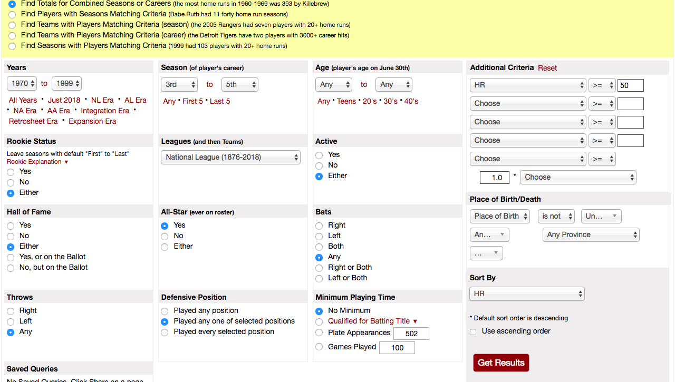
Data Source: Baseball-Reference’s Play Index

Slide 4
Fielding the Data
1) Compiled lists of the top 100 hitters and pitchers by WAR (careers starting 1969 or after)
2) Pulled statistics from their first 3 seasons, and took averages of each stat
3) Looked for the “average” player’s statistics from their first 3 seasons (1969 and beyond) to use as a point of comparison

Slide 5
Rate Stats for Analysis
Hitter stats: Batting Average, Batting Average on Balls in Play (BABIP), Stolen Base %, Runs/At-Bat, HR/At-Bat, RBI/At-Bat, On-Base Percentage (OBP), Slugging Percentage (SLG), On-Base Plus Slugging (OPS)
Pitcher stats: Winning %, HR per 9 Innings, Strikeouts per 9 Innings, Walks per 9 Innings, Strikeout to Walk Ratio (K/BB), Walks + Hits per Inning Pitched (WHIP), Fielding-Independent Pitching (FIP), BABIP, Earned-Run Average (ERA)

Slide 6
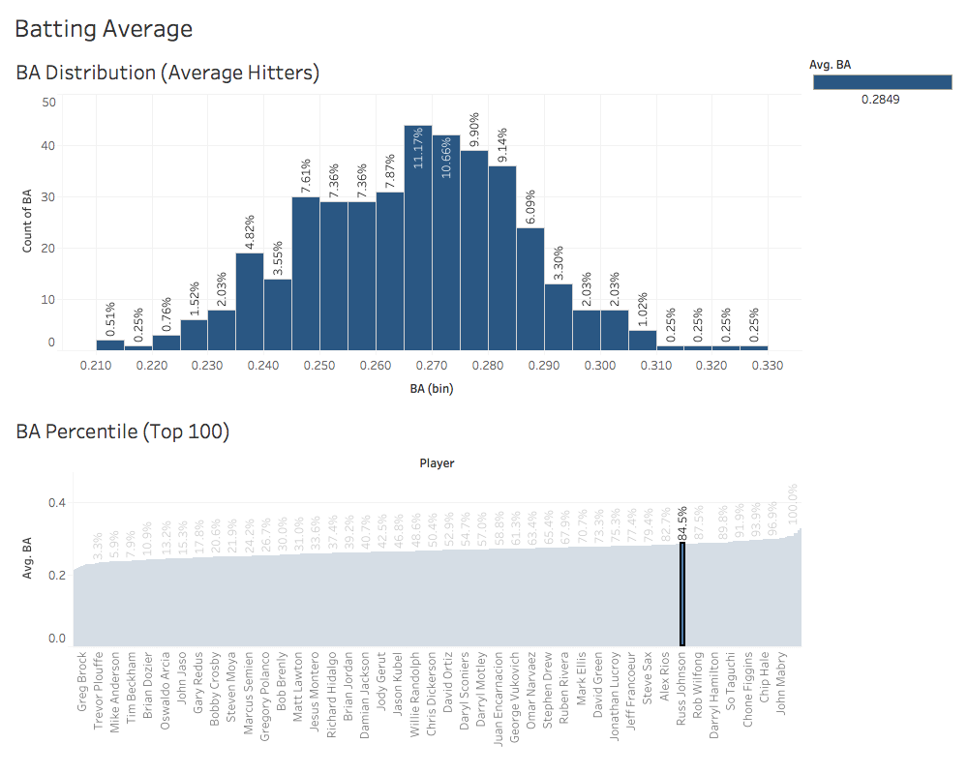
Predictive Hitting Statistics: AVG & R/AB

Slide 7
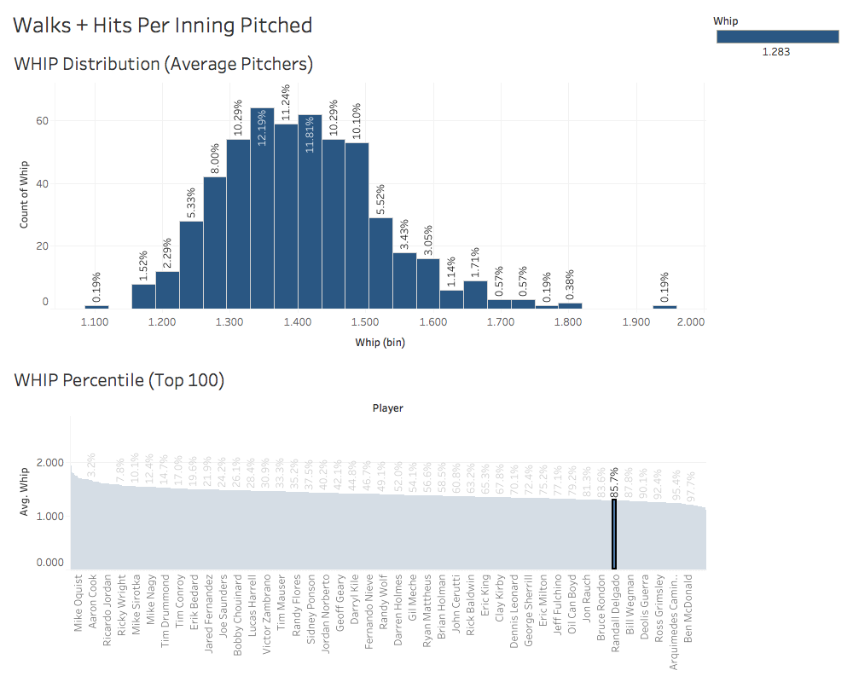
Predicting Pitching Statistics: WHIP and K/BB Ratio

Slide 8
Sign Them Before It’s Too Late!
Hitters
Pitchers
Final Rank | Player | Team | Rk Sum
1 | Corey Seager | LAD | 10
2 | Alex Bregman | HOU | 12.5
3 | Tommy Pham | TBR | 16.5
4 | Trea Turner | WSN | 18
5 | Andrew Benintendi | BOS | 22.5
6 | Carlos Correa | HOU | 24
7 | Trevor Story | COL | 32.5
8 | Jesus Aguilar | MIL | 38
9 | Whit Merrifield | KCR | 39.5
10 | Aledmys Diaz | TOR | 42
12 | Michael Conforto | NYM | 53.5
Final Rank | Player | Team | Rk Sum
1 | Noah Syndergaard | NYM | 2.5
2 | Luis Severino | NYY | 7.5
3 | Kenta Maeda | LAD | 13
4 | Kris Medlen | ARI | 20.5
5 | Yusmeiro Petit | OAK | 24
6 | Jameson Taillon | PIT | 26
7 | Michael Fulmer | DET | 29.5
8 | Andrew Heaney | LAA | 31
9 | Sean Manaea | OAK | 32.5
10 | Jerad Eickhoff | PHI | 35.5

Slide 9
Limitations/Future Analysis
Limitations:
Play Index Limitations: a) Having to measure the “average player” by ERA+ and OPS+, b) Having to slice the data by first 3 seasons rather than x # of games or innings
WAR is derived from literally every other statistic
This analysis excludes: defense and (mostly) relief pitchers
Future Analysis: Slicing the data by position

Slide 10
Inside Baseball: Next Steps
Assess your team’s need for young hitting or pitching, and what you’re willing to give up/spend to get it
Contact the agents of the players on the two lists of top players to target based on our statistical analysis, and see if you can strike up a trade (or negotiate a contract, if he’s already on your team!)
If you’re willing to pay top dollar, Noah Syndergaard and Luis Severino are your two best pitchers to target, and Corey Seager and Alex Bregman are your top hitters

Slide 11
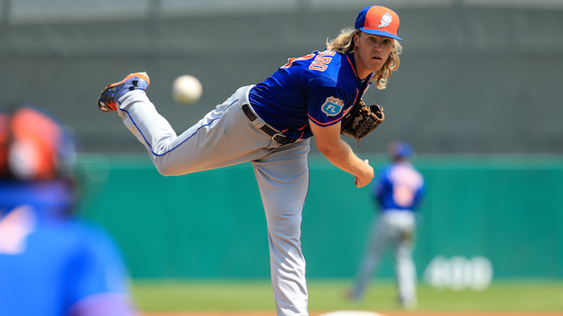
When Life Throws You A Curveball

